Slide 1
Eco-Meet 2013
Songbirds

Slide 2
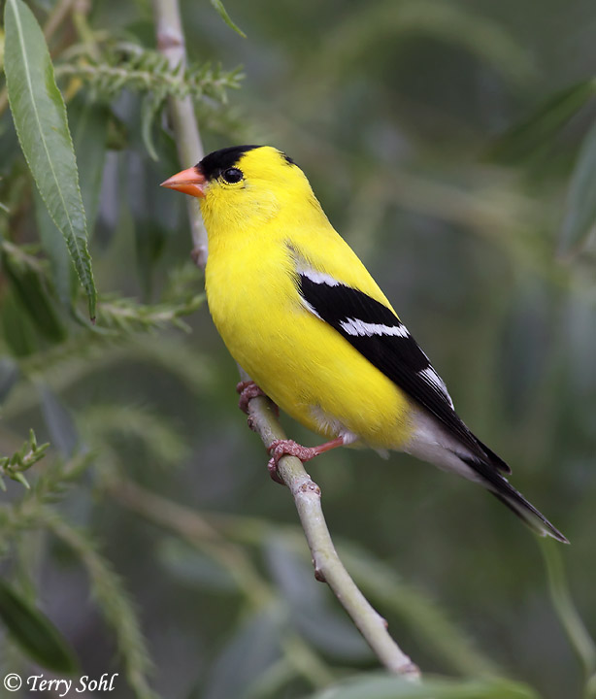
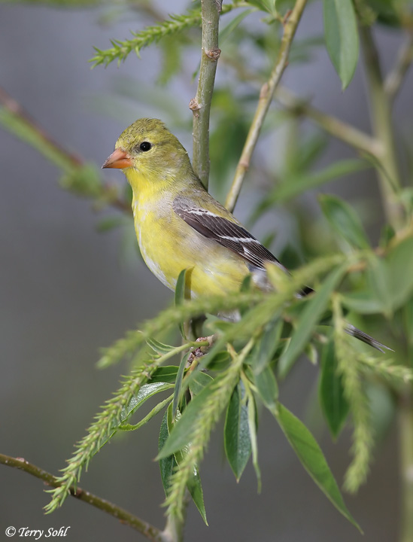
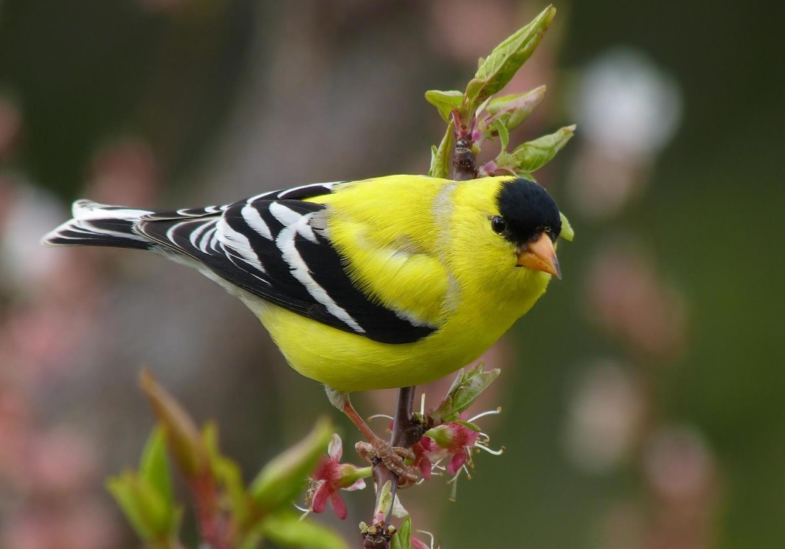
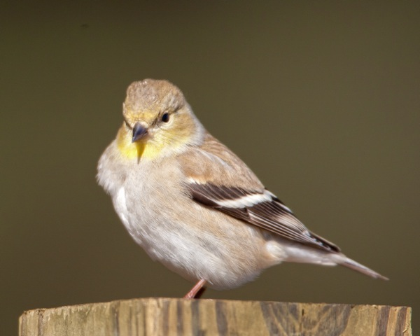

Slide 3
American Goldfinch
http://www.allaboutbirds.org/guide/american_goldfinch/sounds

Slide 4
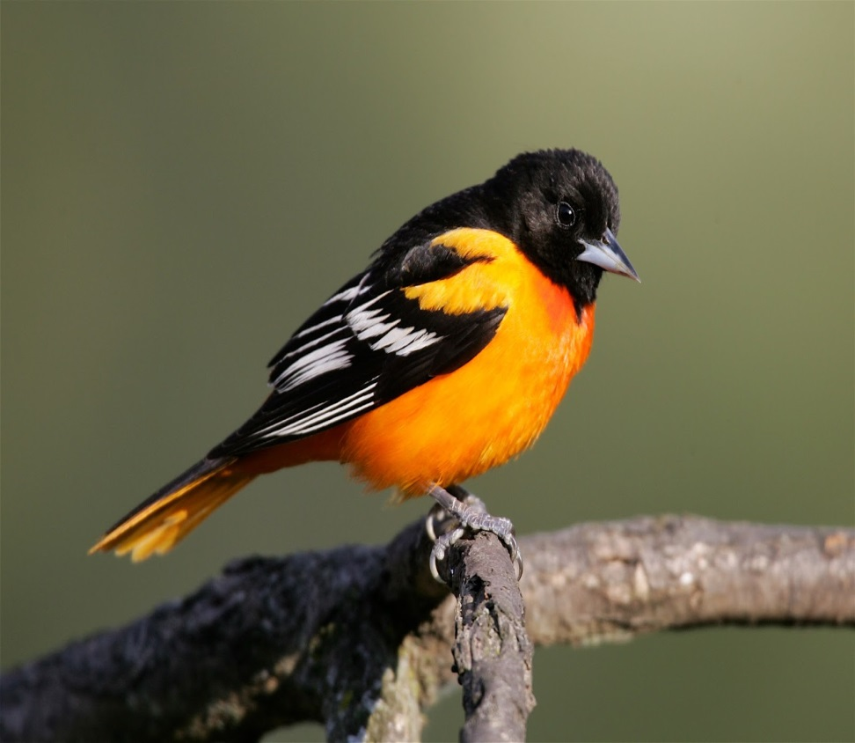
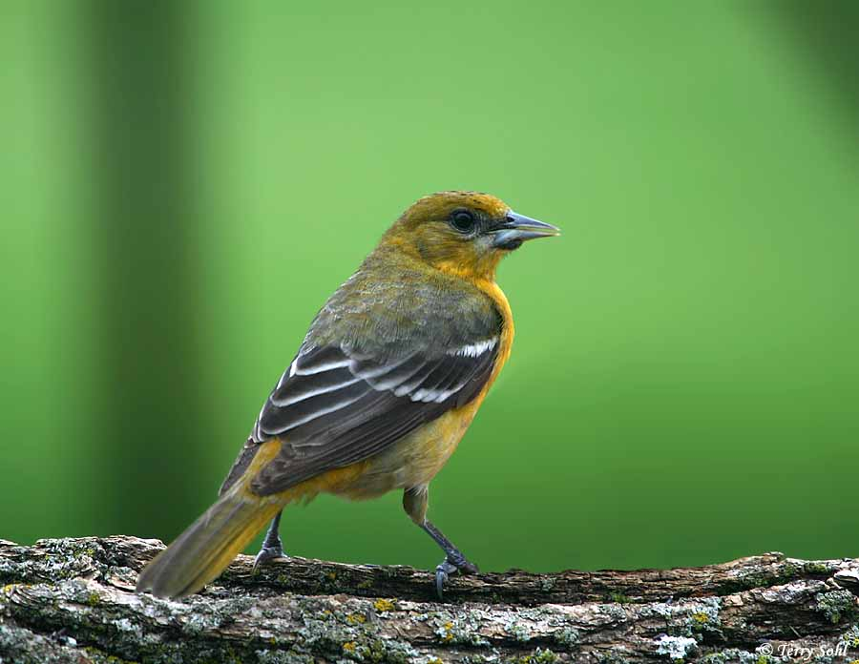
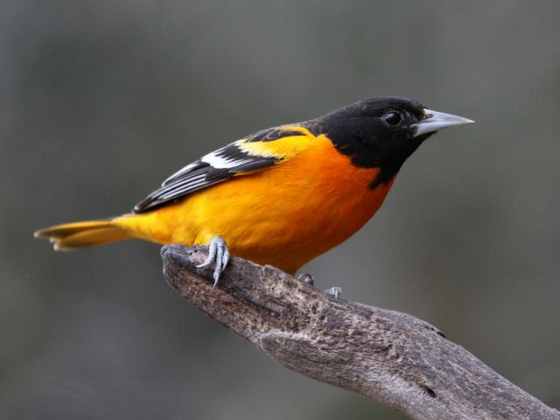
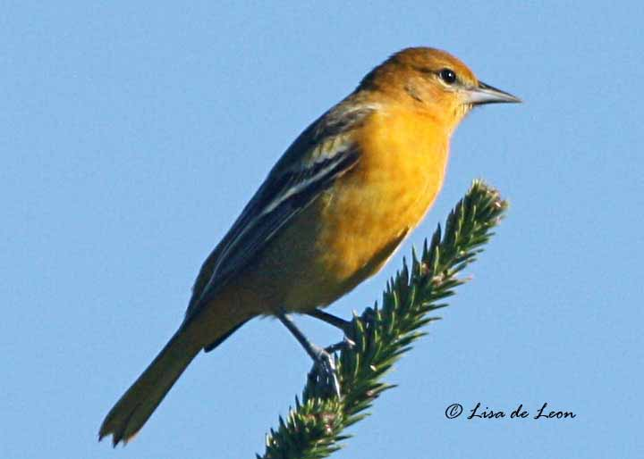

Slide 5
Baltimore Oriole
http://www.allaboutbirds.org/guide/Baltimore_Oriole/sounds

Slide 6
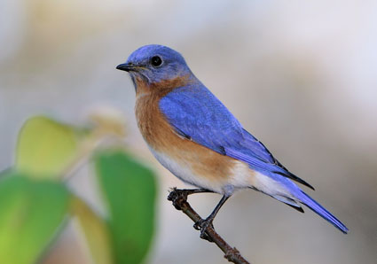
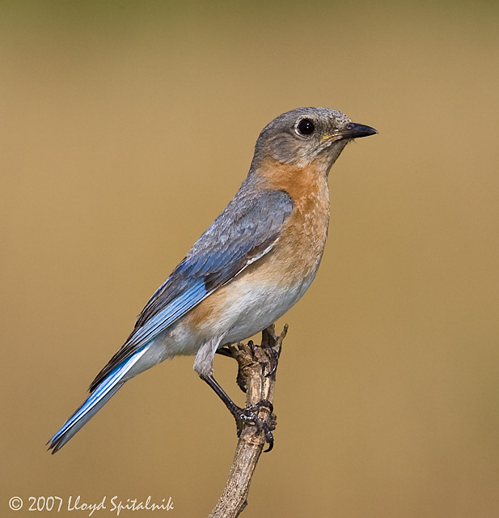
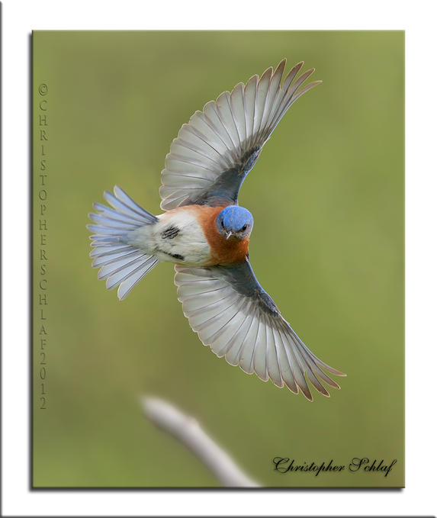
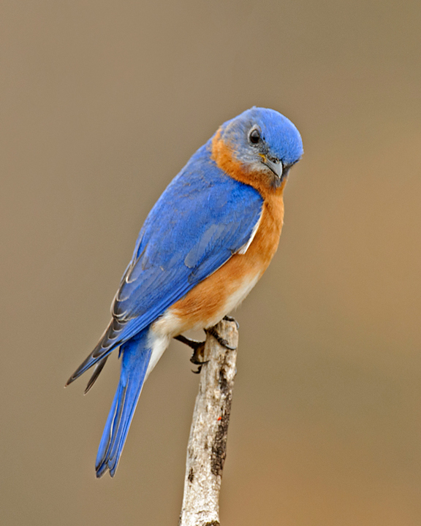
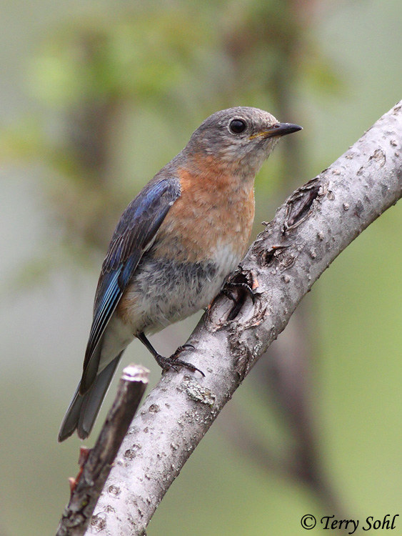

Slide 7
Eastern Blue Bird
http://www.allaboutbirds.org/guide/Eastern_Bluebird/sounds

Slide 8
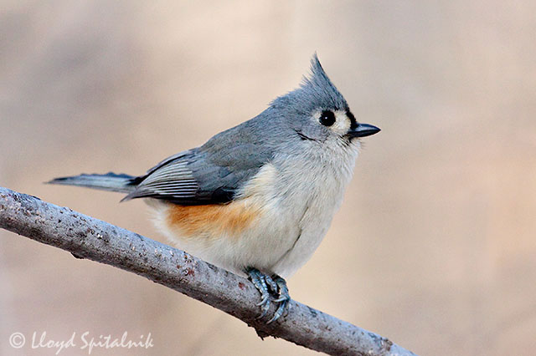
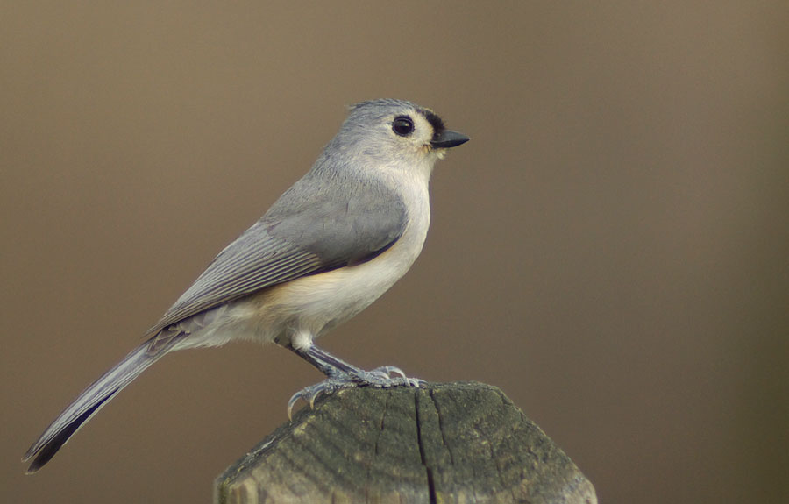
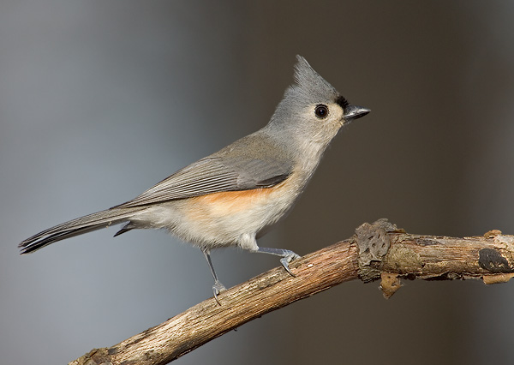
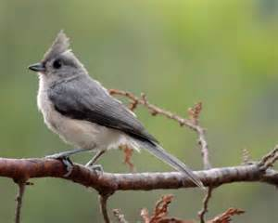

Slide 9
Tufted Titmouse
http://www.allaboutbirds.org/guide/tufted_titmouse/sounds

Slide 10
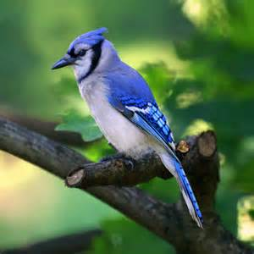
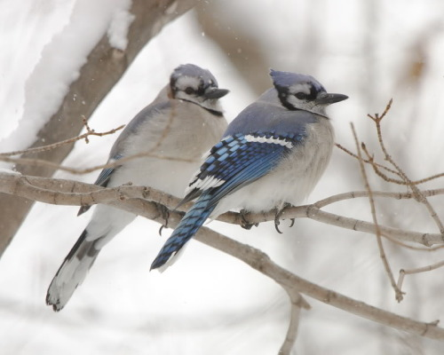
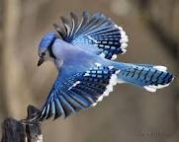
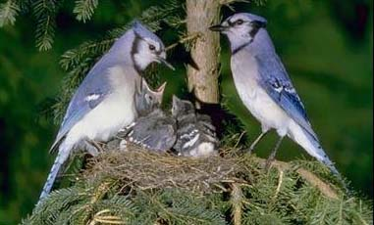

Slide 11
Blue Jay
http://www.allaboutbirds.org/guide/blue_jay/sounds

Slide 12
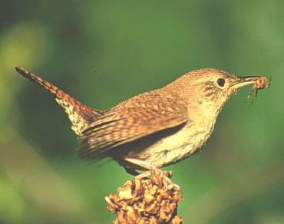
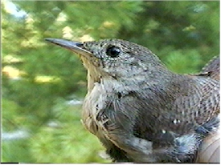
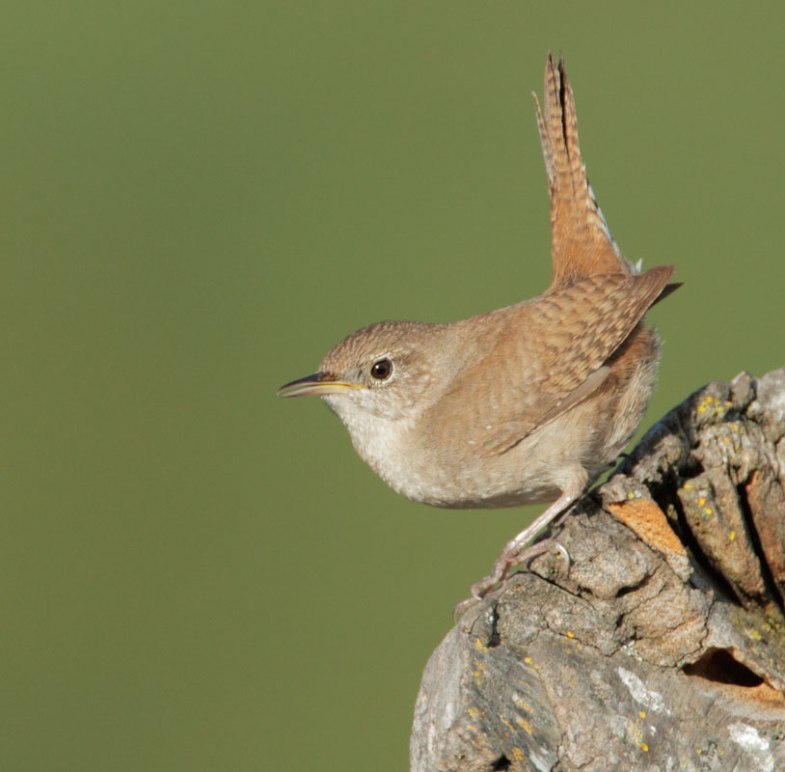
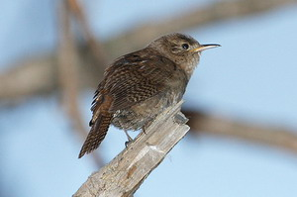

Slide 13
House Wren
http://www.allaboutbirds.org/guide/house_wren/sounds

Slide 14
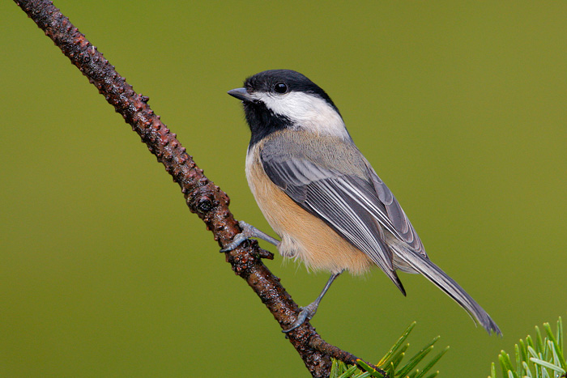
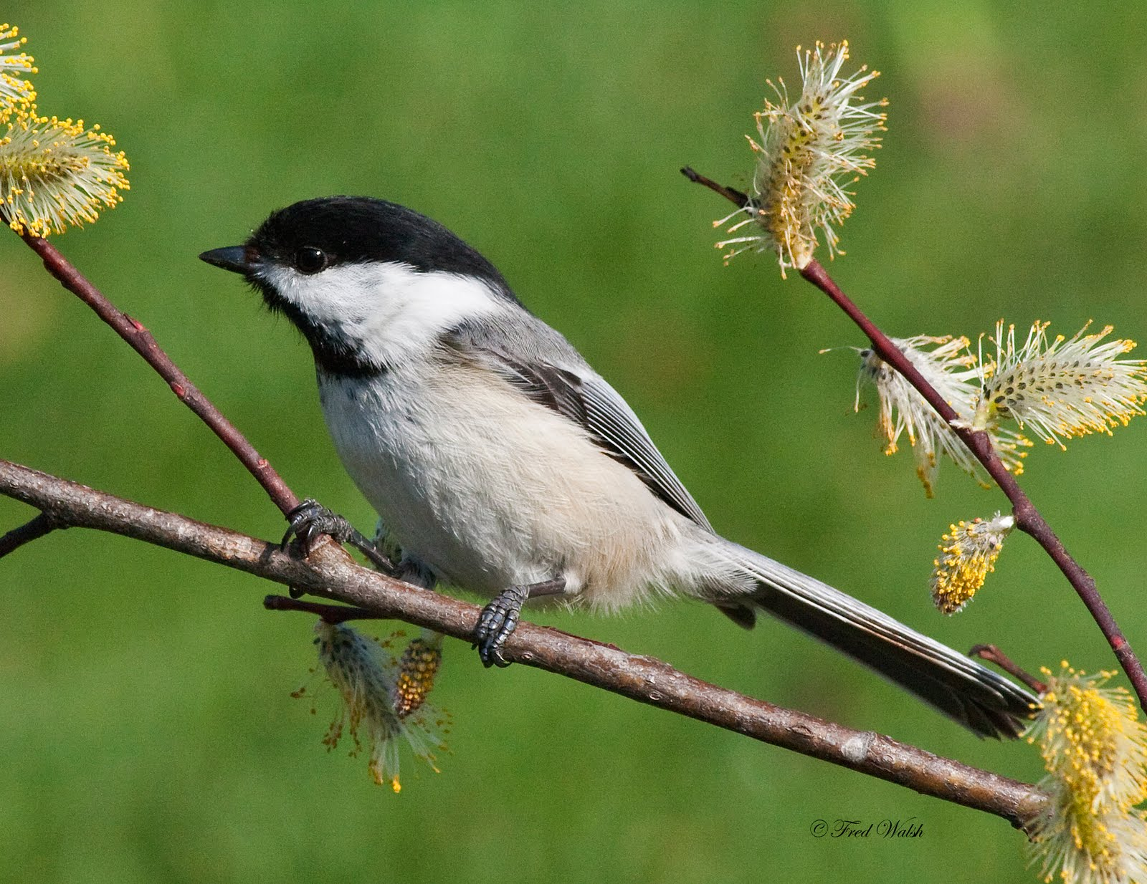
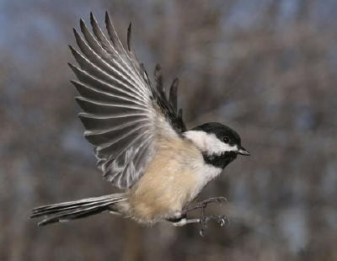
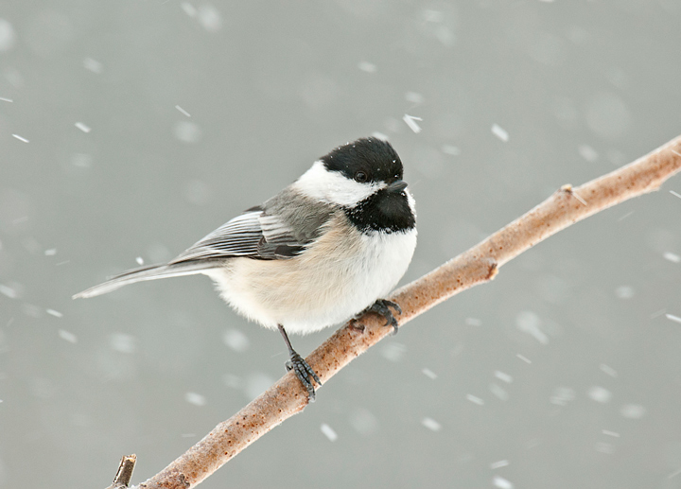

Slide 15
Black-Capped Chickadee
http://www.allaboutbirds.org/guide/Black-capped_Chickadee/sounds

Slide 16
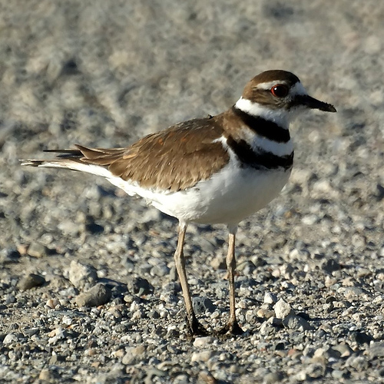
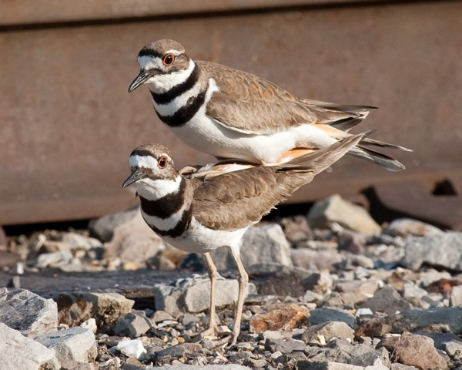
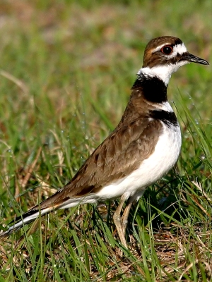
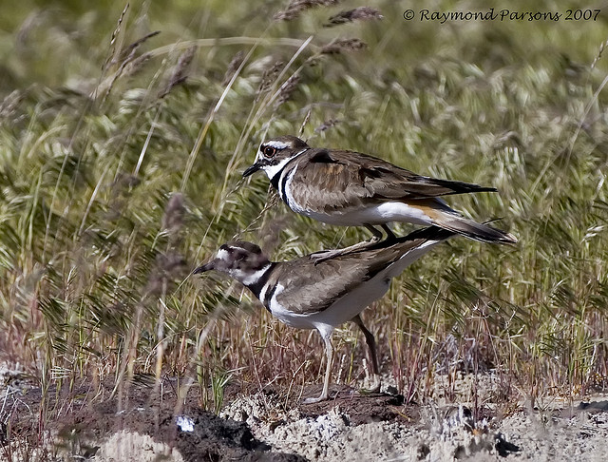

Slide 17
Killdeer
http://www.birdjam.com/birdsong.php?id=18

Slide 18
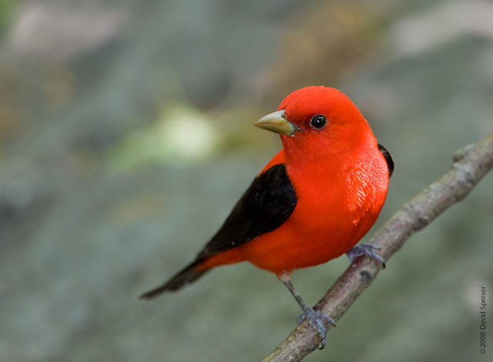
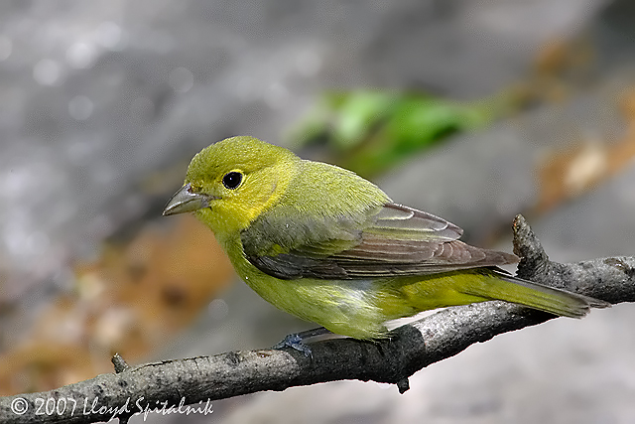
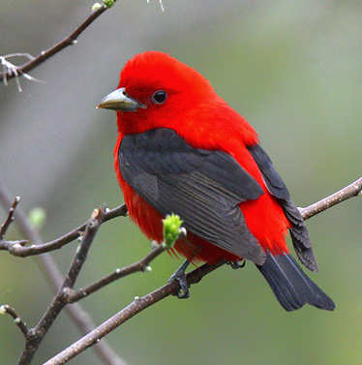
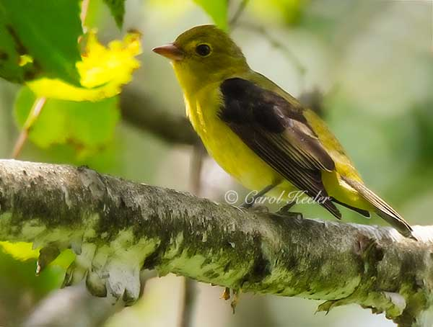

Slide 19
Scarlet Tanager
http://www.allaboutbirds.org/guide/Scarlet_Tanager/sounds

Slide 20
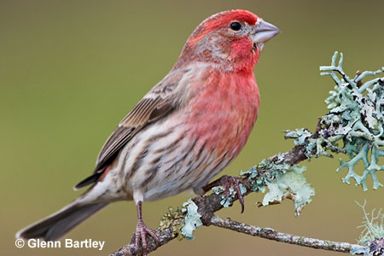
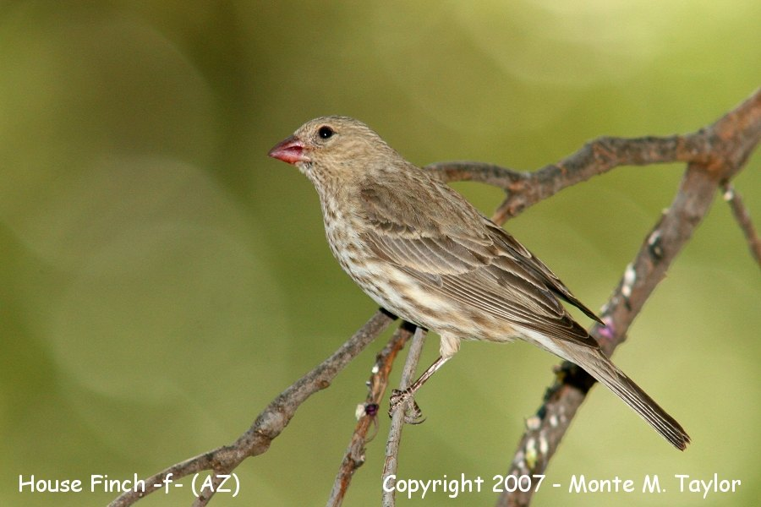
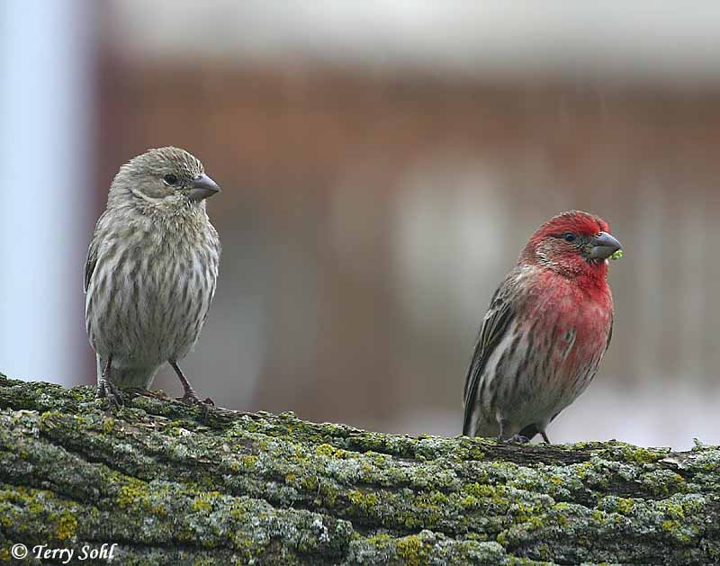
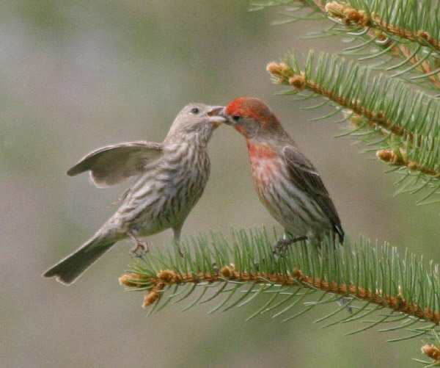

Slide 21
House Finch
http://www.allaboutbirds.org/guide/House_Finch/sounds

Slide 22
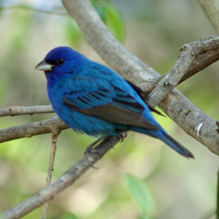
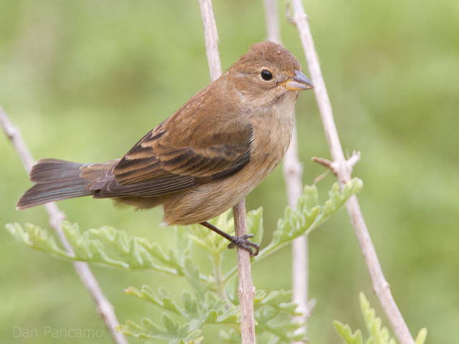
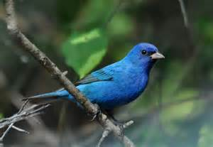
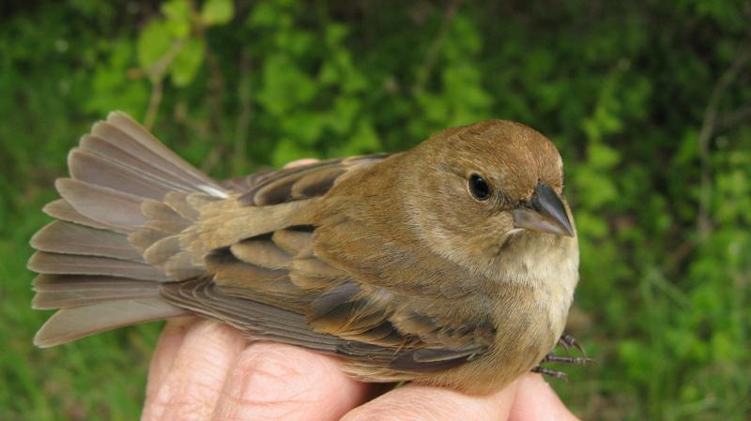

Slide 23
Indigo Bunting
http://www.allaboutbirds.org/guide/Indigo_Bunting/sounds

Slide 24
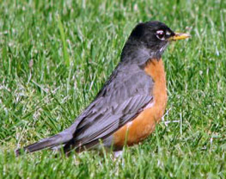
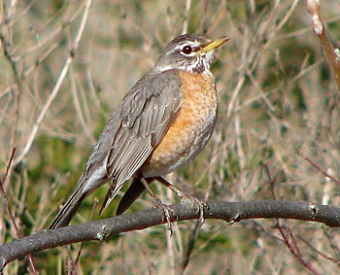
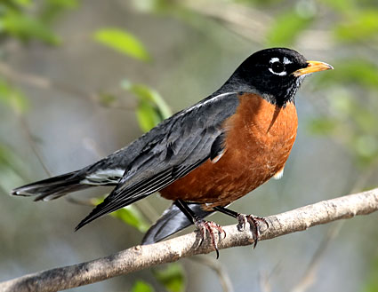
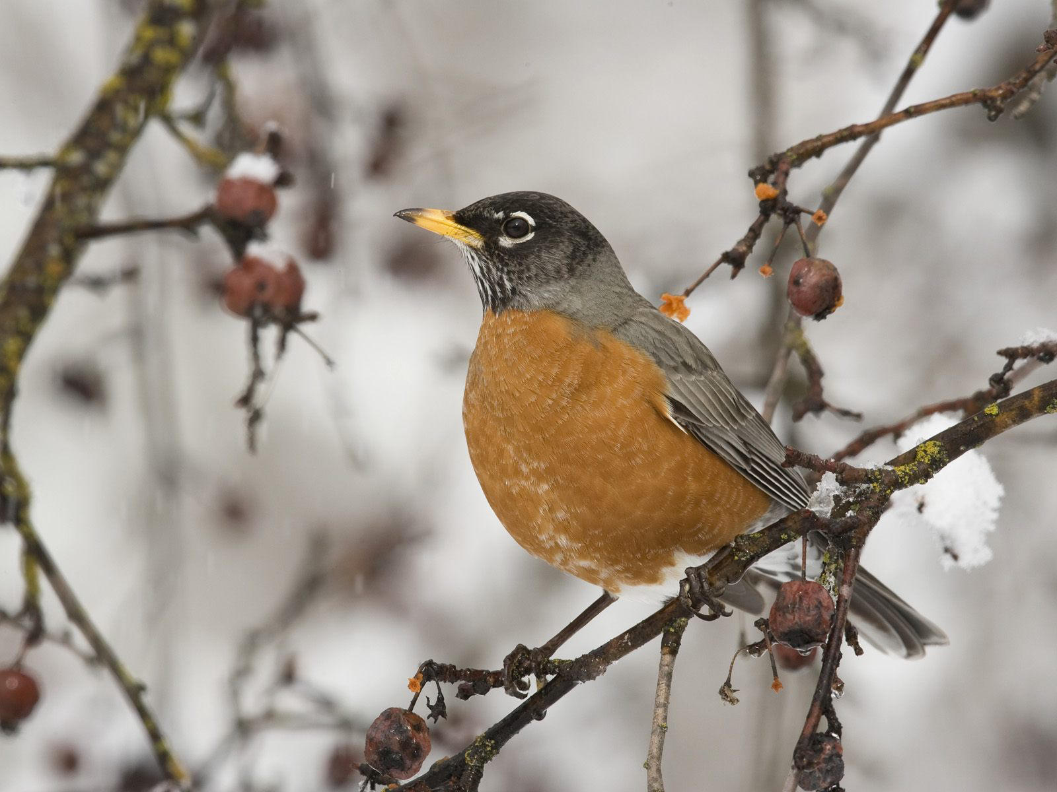

Slide 25
American Robin
http://www.allaboutbirds.org/guide/American_Robin/sounds

Slide 26
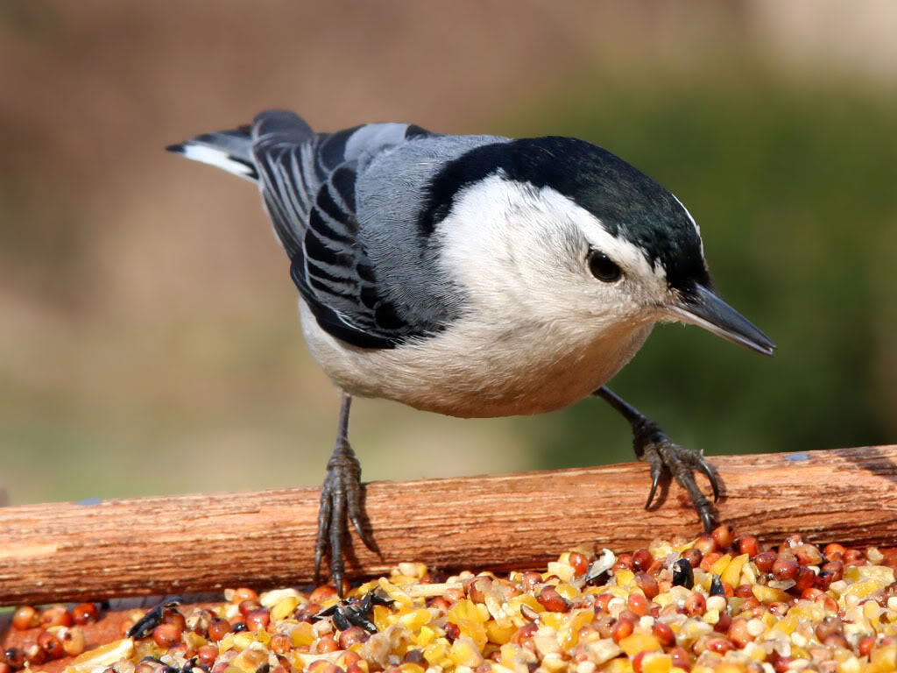

Slide 27
White-Breasted Nuthatch
http://www.allaboutbirds.org/guide/Whitebreasted_Nuthatch/sounds

Slide 29
Northern Cardinal
http://www.allaboutbirds.org/guide/Northern_Cardinal/sounds

Slide 31
Chipping Sparrow
http://www.allaboutbirds.org/guide/Chipping_Sparrow/sounds

Slide 33
Brown-headed Cowbird
http://www.allaboutbirds.org/guide/Brown-headed_Cowbird/sounds

